Slide 1
2024/8/25~2024/8/31
LP-N5 多批性 2 o’clock defect 8D report

Slide 2
Discipline 1. 選定團隊 Form the Team
團隊負責人Team Leader/Dept.: 林韋志/S220
成員Team Member/Dept.:
Name | Department | Position
S210 PE | S210 | 擴散製程課
S220 EQ | S220 | 擴散設備課

Slide 3
Discipline 2.描述問題及現況掌握Describe the Problem
(WHO detected the problem? WHAT is wrong? State the problem in terms of object and defect. WHERE the problem was first detected, describe location of the detection, lot #, WHEN and HOW it was detected)
What | S730 Highlight C031JI-Y47443-24352630-9714_op (spec. <5%) No OOS, defect rate: 0.67~3.61% A total of 23 pcs have a local map OM check by under defect issue
Where | LP-N5
When | 2024/8/31
Extent | On hold record check: 4217_op LP-N5 PTC issue Suspect impact machine: 4217_op LP-N5 (8/31) Issue entity LP-N5 (8/25~8/31) 有多批 impact lot (Def% 1~3.5%)

Slide 4
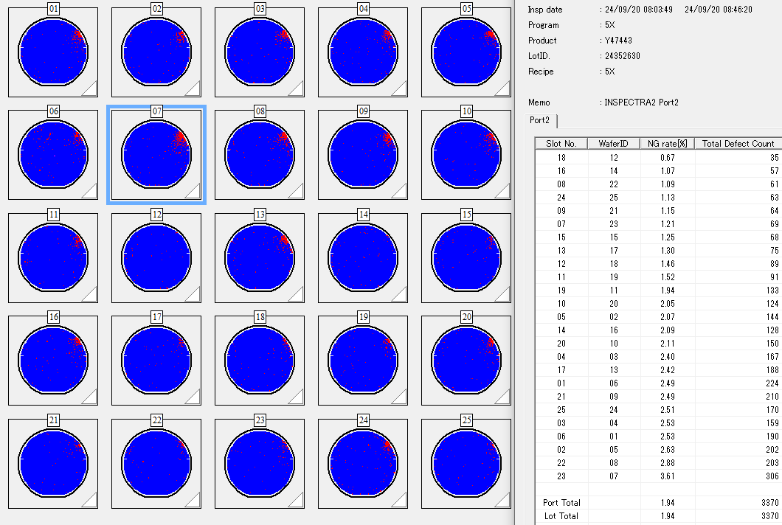
Discipline 2.描述問題及現況掌握Describe the Problem
lot History - 調查過程簡述 (Investigation):
Event 1: C031JI-Y47443-24352630-9714_op (spec <5%)
No pcs OOS Def%: 0.67~3.61%

Slide 5
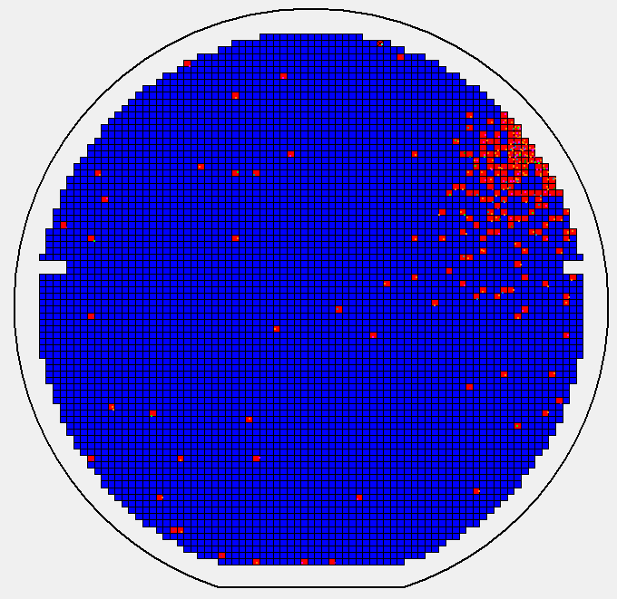
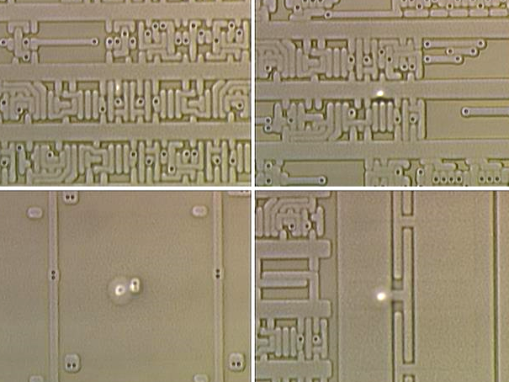
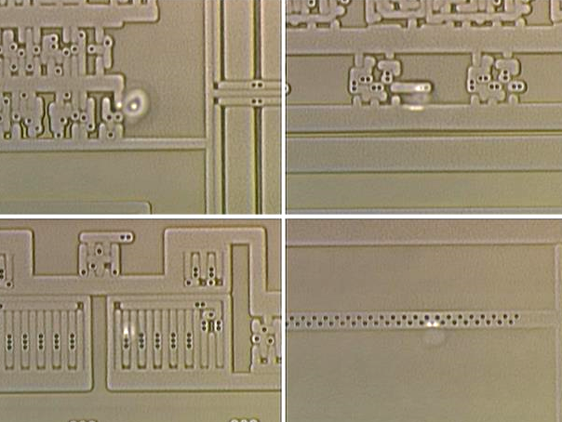
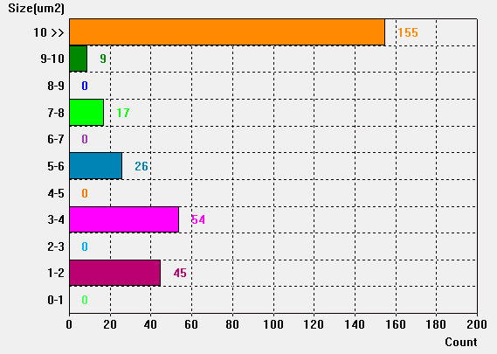
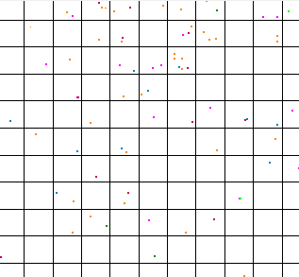
Discipline 2.描述問題及現況掌握Describe the Problem
#7
Event 1: C031JI-Y47443-24352630-9714_op
AOI defect map check: by local (2 o’clock)
Defect size: >10 μm
Leica Pictures OM Check by under defect Issue

Slide 6
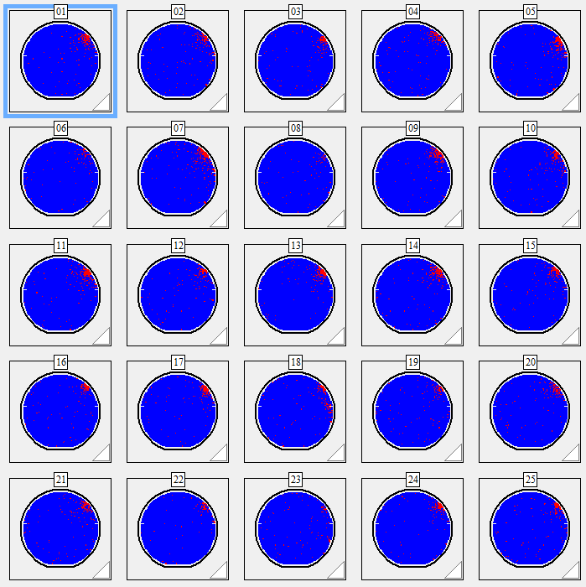
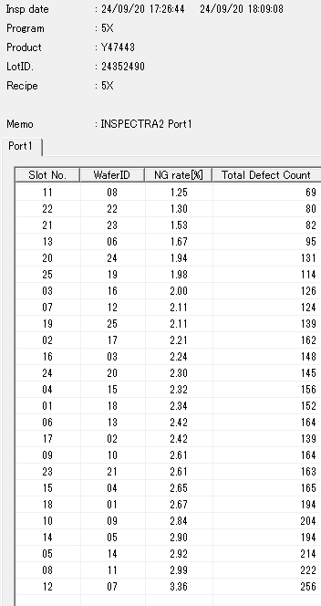
Discipline 2.描述問題及現況掌握Describe the Problem
Event 2: C031JI-Y47443-24352490-9714_op (spec <5%)
No pcs OOS Def%: 1.25~3.36%

Slide 7
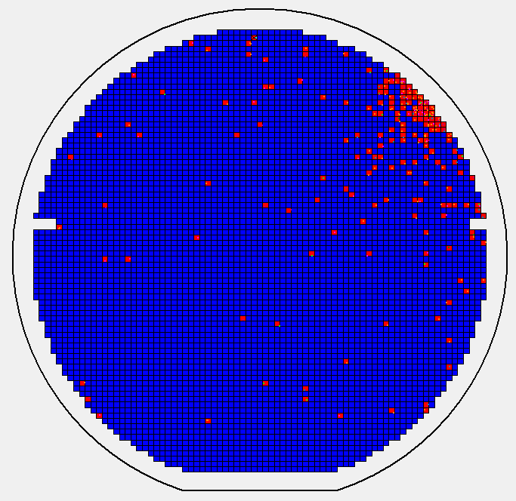
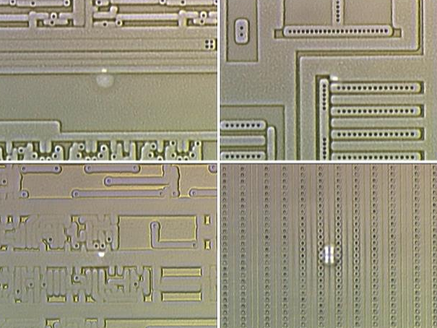
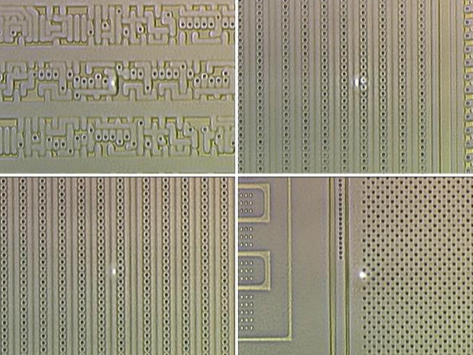
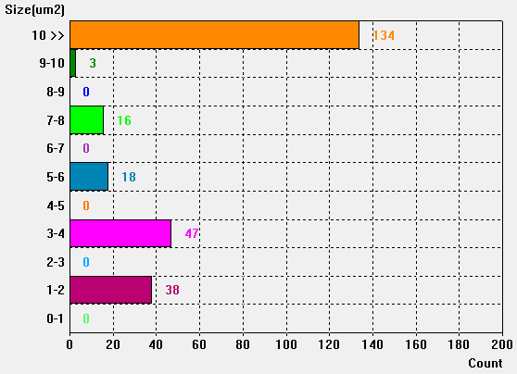
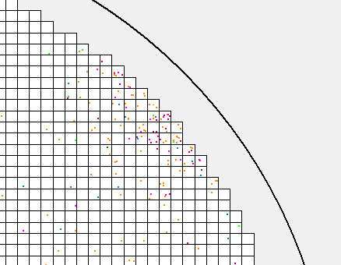
Discipline 2.描述問題及現況掌握Describe the Problem
#7
Event 2: C031JI-Y47443-24352490-9714_op
AOI defect map check: by local (2 o’clock)
Defect size: >10 μm
Leica Pictures OM Check by under defect Issue

Slide 8
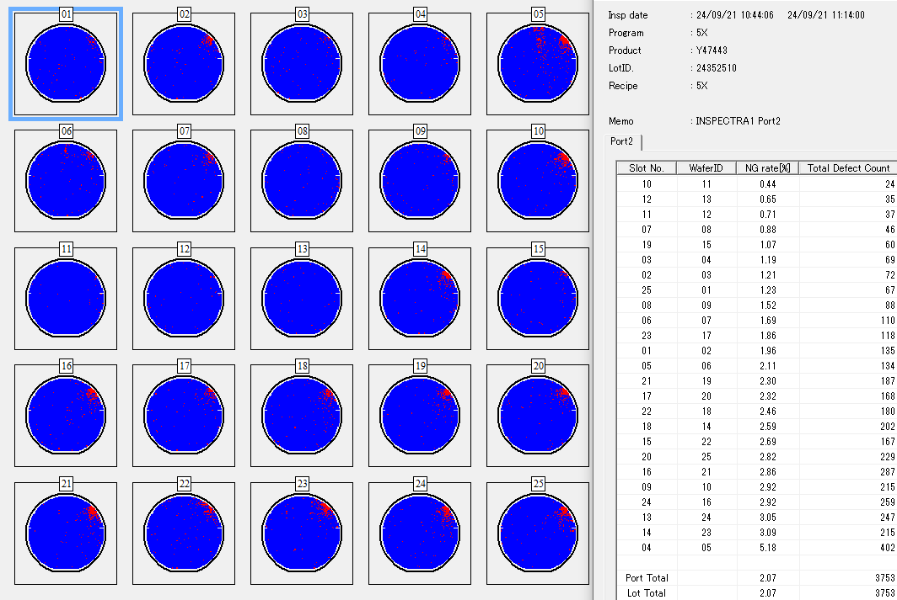
Discipline 2.描述問題及現況掌握Describe the Problem
Event 3: C031JI-Y47443-24352510-9714_op (spec <5%)
single pcs OOS Def%: 0.44~5.18%

Slide 9
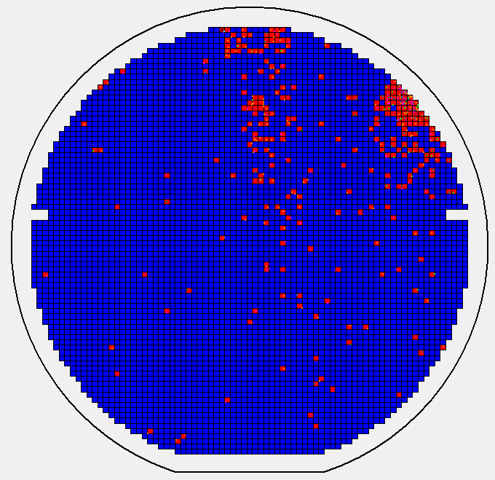
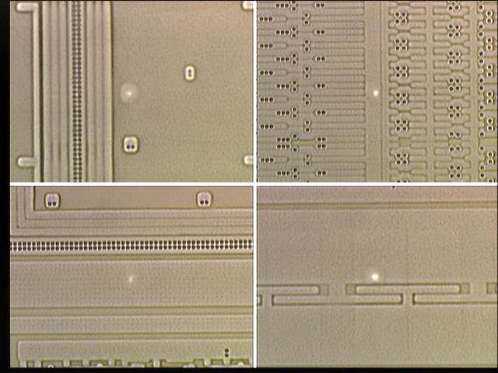
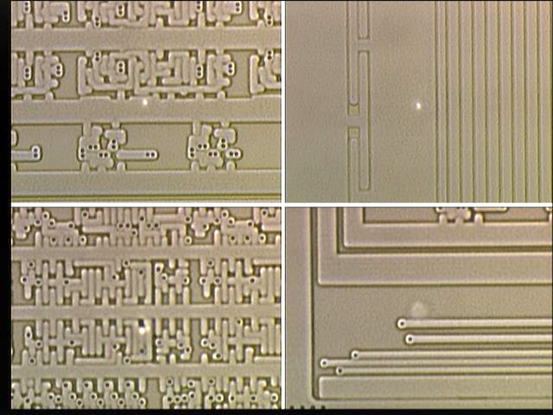
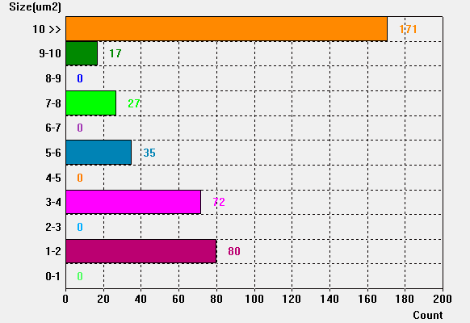
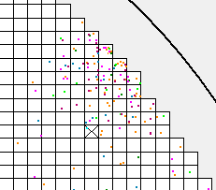
Discipline 2.描述問題及現況掌握Describe the Problem
#5
Event 3: C031JI-Y47443-24352510-9714_op
AOI defect map check: by local (2 o’clock)
Defect size: >10 μm
Leica Pictures OM Check by under defect Issue

Slide 10
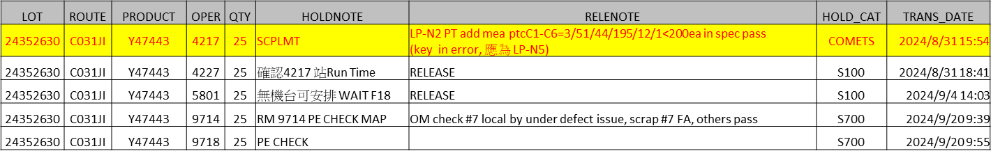
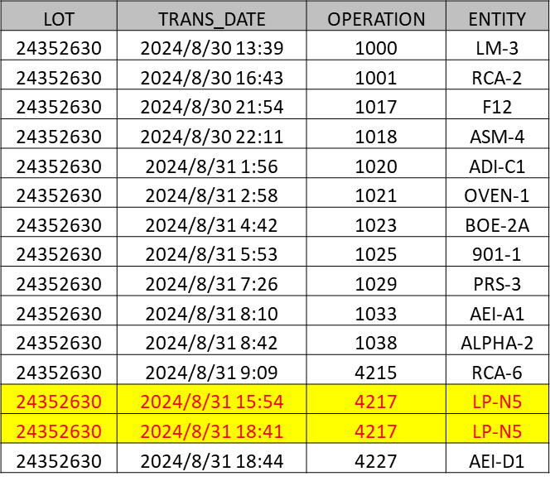
Discipline 2.描述問題及現況掌握Describe the Problem
On hold record check: 4217_op LP-N5 PTC issue
Under layer AOI check: NA
Suspect impact machine: 4217_op LP-N5 (8/31)

Slide 11
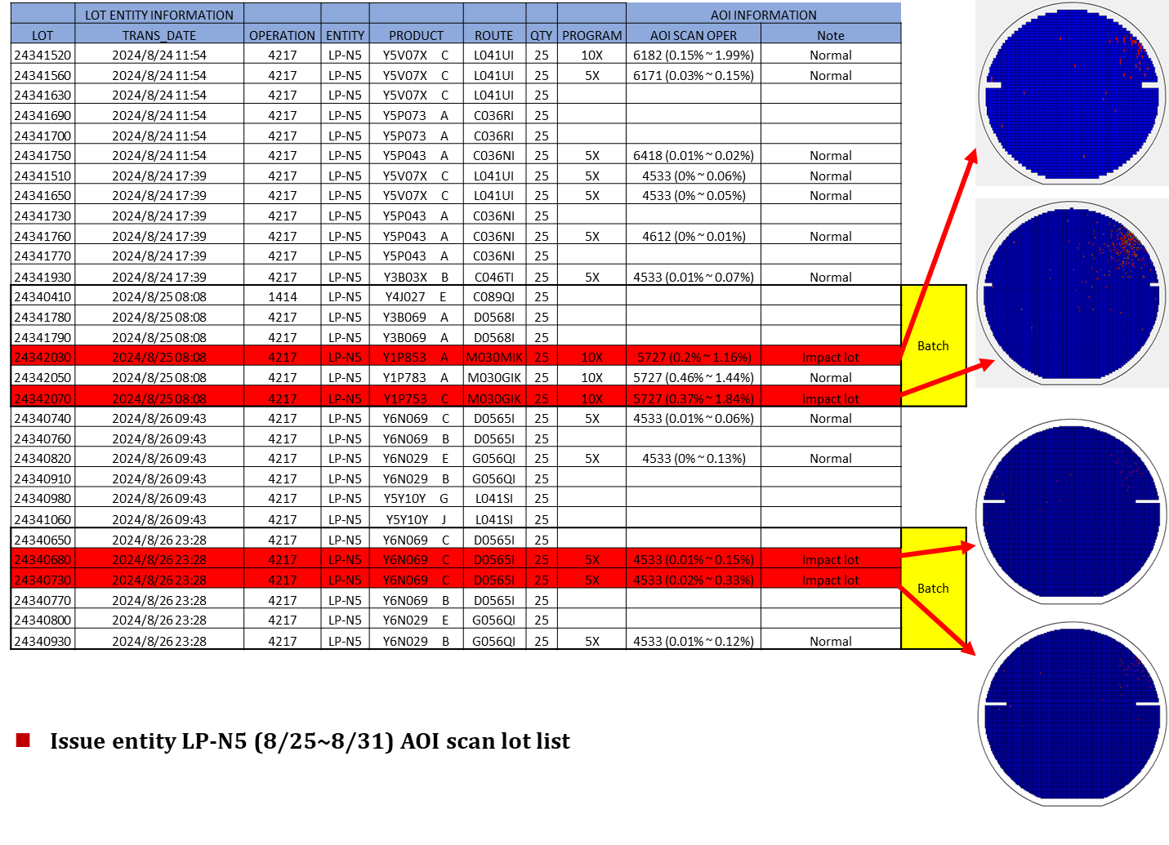
Discipline 2.描述問題及現況掌握Describe the Problem

Slide 12
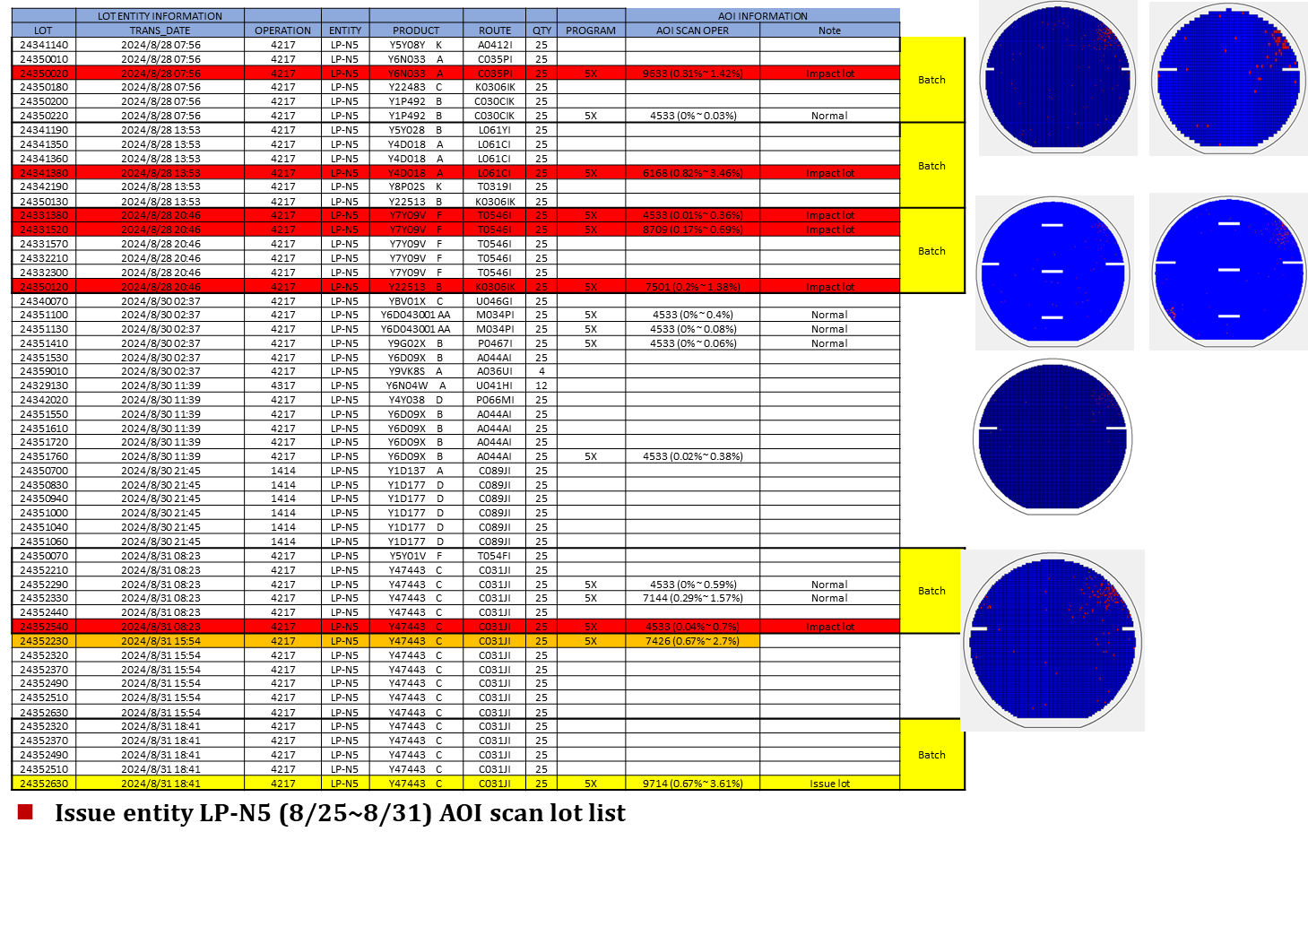
Discipline 2.描述問題及現況掌握Describe the Problem

Slide 13
Discipline 2.描述問題及現況掌握Describe the Problem
Is/Is Not Analysis table (釐清問題):
 |  | Is | Is Not | Difference/Conclusion
What | Object | Particle OOC | Normal | Particle OOC
 | Defect | 2 o’clock defect | Normal | 2 o’clock defect
Where | Location | FAB D-Tunnel | Other place | FAB D-Tunnel
 | Machine | LP-N5 | NA | Other machine
When | First time | 2024/8/25 | Not before | First time, Not Before
 | Reoccurred | - | - | NA
How | Many | 11 lots / 275 pcs | Other lot | 11 lots / 275 pcs
 | Trend | - | - | NA

Slide 14
Discipline 3.執行及驗證暫時防堵對策 Contain the Problem
(Define and implement containment actions to isolate the effect of problem from any internal/external customer until corrective action is implemented)
3.1 異常產品 (Defect Lots)
項目 Item | 處理方式 Action | 負責人員 Resp | 預定完成日 Due | 實際完成日 Imp. | 處理結果 Verification
24352490 | AOI scan | S210 | 09/21 | 09/21 | Def%：#05 5.18% scrap， others 0.44~3.09% pass

Slide 15
Discipline 3.執行及驗證暫時防堵對策 Contain the Problem
(Define and implement containment actions to isolate the effect of problem from any internal/external customer until corrective action is implemented)
3.2 波及產品 (Impact Lots)
項目 Item | 處理方式 Action | 負責人員 Resp | 預定完成日 Due | 實際完成日 Imp. | 處理結果 Verification
24342030 24342070 24340680 24340730 24350020 24341380 24331380 24331520 24350120 24352540 | AOI scan | S210 | 09/21 | 09/21 | Def% all < 5%，pass

Slide 16
Discipline 3.執行及驗證暫時防堵對策 Contain the Problem
(Define and implement containment actions to isolate the effect of problem from any internal/external customer until corrective action is implemented)
3.3 波及設備 (Impact Machine)
項目 Item | 處理方式 Action | 負責人員 Resp | 預定完成日 Due | 實際完成日 Imp. | 處理結果 Verification
LP-N5 | 停機檢查機台 | S220 EQ | 2024/8/31 | 2024/8/31 | Check 磁性流體抖動異常， 更換磁性流體 ok
3.4 波及製程 (Impact Route) : 否(No)
項目 Item | 處理方式 Action | 負責人員 Resp | 預定完成日 Due | 實際完成日 Imp. | 處理結果 Verification
NA | NA | NA | NA | NA | NA
3.5 產品召回選項，是否需進行客戶端波及產品的召回? 否(No)
Customer | Product No. | Lot number / Wafer number | Approx. Quantity
NA | NA | NA | NA

Slide 17
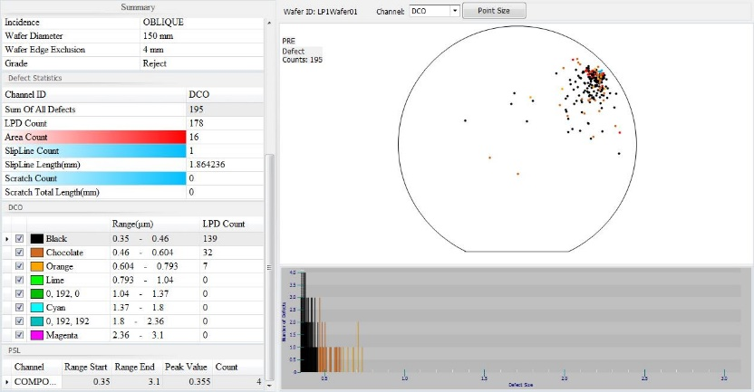
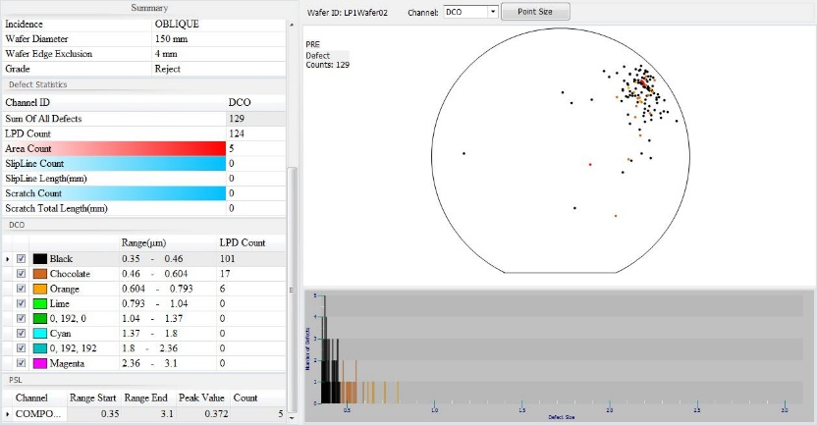
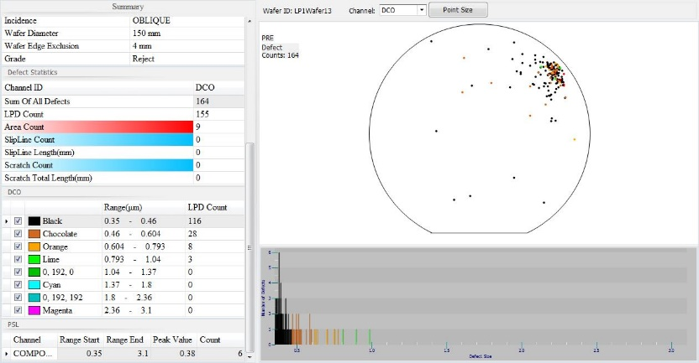
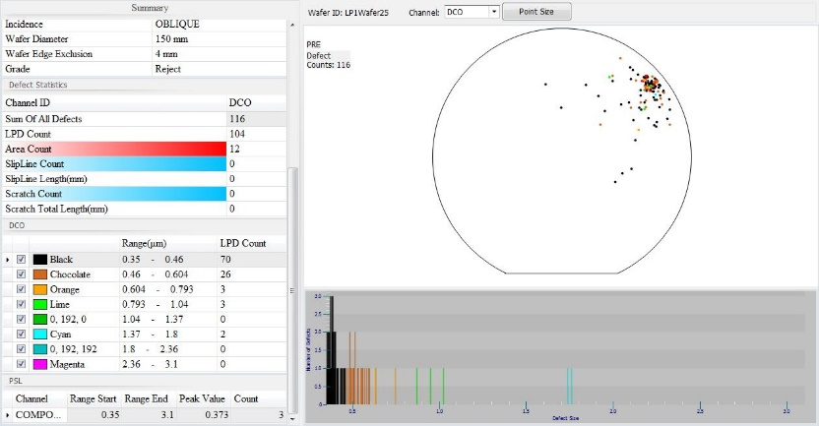
Discipline 3.執行及驗證暫時防堵對策 Contain the Problem
2024/8/31 run N01 C4 particle=194 OOC，check map 集中於 2 點鐘方向 pattern。
加量 C1~C6 particle=3/51/44/194/12/1，only C4 OOC。
加量 C1 slot2/slot13/slot25 particle=129/164/116 皆 OOC (2 點鐘方向 pattern)。
產品洽 PE check，停機檢查機台。
C4 slot1
C4 slot2
C4 slot13
C4 slot25

Slide 18
Discipline 4.定義及驗證真因 (Identify the Root Cause)
(Identify all potential causes which could explain why the problem occurred)
4.1 Non-conformance root cause (defect nature / technical root cause):
a) Failure mechanism:
加量 particle map 於 2 點鐘方向皆有異常 pattern，進行機台檢查確認。

Slide 19
Discipline 4.定義及驗證真因 (Identify the Root Cause)
(Identify all potential causes which could explain why the problem occurred)
4.1 Non-conformance root cause (defect nature / technical root cause):
b) 列出所有可能的原因 (Probable Causes/Factors): Non-conformance
工具 (Tools): 故障樹分析 (Fault Tree Analysis)、魚骨圖 (Fishbone)
石英異常
壓力異常
Tube
Pump
Vent 氣聲
Boat
APC
Pedestal
http://home.rapidbbs.cn/?fromuid=22138
Particle OOC
刮管
刮傷
磁性流體
傳送相關異常

Slide 20
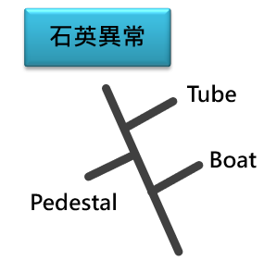
Discipline 4.定義及驗證真因 (Identify the Root Cause)
(Identify all potential causes which could explain why the problem occurred)
4.1 Non-conformance root cause (defect nature / technical root cause):
c) 真因驗證 (Root Cause Verification)
石英異常： 1. Tube： 檢視 Tube 無髒污 & 破損，非真因。 2. Pedestal： 檢視 Pedestal 無髒污 & 破損，非真因。 3. Boat： 檢視 Boat 無髒污 & 破損，非真因。

Slide 21
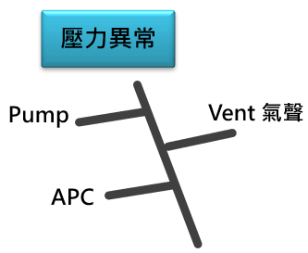
Discipline 4.定義及驗證真因 (Identify the Root Cause)
(Identify all potential causes which could explain why the problem occurred)
4.1 Non-conformance root cause (defect nature / technical root cause):
c) 真因驗證 (Root Cause Verification)
壓力異常： 1. Pump： Check RMS issue run pump 壓力正常，亦無 pump 相關 alarm，非真因。 2. Vent 氣聲： 測試 vent 氣聲正常，非真因。
SampleTime | Tube | State | Recipe | RemainingS | Step | RemainingT | Temp | Press | Remk | Angle
2024/8/31 11:51 | LP-N5 | RUN | LN5N01 | 0002:24:42 | 4 | 00:05:30 | 780 | 0 |  | 500.59
2024/8/31 11:51 | LP-N5 | RUN | LN5N01 | 0002:24:42 | 4 | 00:05:30 | 780 | 0 |  | 500.59
2024/8/31 11:52 | LP-N5 | RUN | LN5N01 | 0002:24:42 | 4 | 00:05:30 | 780 | 0 |  | 500.59
2024/8/31 11:52 | LP-N5 | RUN | LN5N01 | 0002:23:02 | 4 | 00:03:50 | 778 | 0 |  | 500.59
2024/8/31 11:53 | LP-N5 | RUN | LN5N01 | 0002:23:02 | 4 | 00:03:50 | 778 | 0 |  | 500.56
2024/8/31 11:53 | LP-N5 | RUN | LN5N01 | 0002:23:02 | 4 | 00:03:50 | 778 | 0 |  | 500.59
2024/8/31 11:54 | LP-N5 | RUN | LN5N01 | 0002:23:02 | 4 | 00:03:50 | 778 | 0 |  | 500.59
2024/8/31 11:54 | LP-N5 | RUN | LN5N01 | 0002:21:17 | 4 | 00:02:05 | 776.2 | 0 |  | 500.59
2024/8/31 11:55 | LP-N5 | RUN | LN5N01 | 0002:21:17 | 4 | 00:02:05 | 776.2 | 0 |  | 500.59
2024/8/31 11:55 | LP-N5 | RUN | LN5N01 | 0002:21:17 | 4 | 00:02:05 | 776.2 | 0 |  | 500.59
2024/8/31 11:56 | LP-N5 | RUN | LN5N01 | 0002:19:32 | 4 | 00:00:20 | 774.7 | 0 |  | 500.59
2024/8/31 11:56 | LP-N5 | RUN | LN5N01 | 0002:19:32 | 4 | 00:00:20 | 774.7 | 0 |  | 500.59
2024/8/31 11:57 | LP-N5 | RUN | LN5N01 | 0002:19:32 | 4 | 00:00:20 | 774.7 | 0 |  | 500.59
2024/8/31 11:57 | LP-N5 | RUN | LN5N01 | 0002:19:32 | 4 | 00:00:20 | 774.7 | 0 |  | 500.59

Slide 22
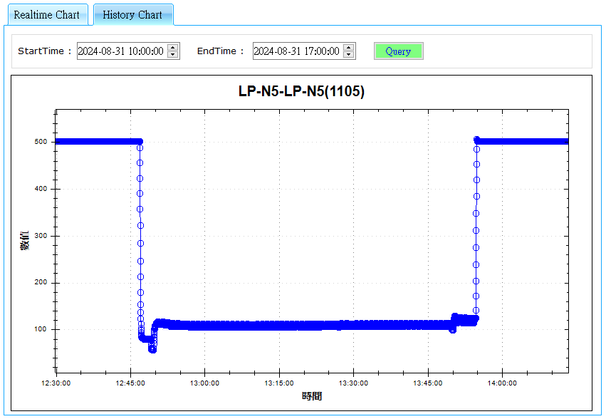
Discipline 4.定義及驗證真因 (Identify the Root Cause)
(Identify all potential causes which could explain why the problem occurred)
4.1 Non-conformance root cause (defect nature / technical root cause):
c) 真因驗證 (Root Cause Verification)
壓力異常： 3. APC： Check issue run step.17 反應步驟 APC angle=104~113 stable，servo 壓力亦正常，非真因。
step.17 反應步驟

Slide 23
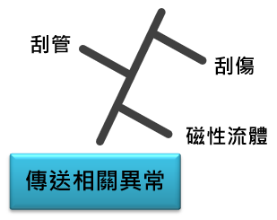
Discipline 4.定義及驗證真因 (Identify the Root Cause)
(Identify all potential causes which could explain why the problem occurred)
4.1 Non-conformance root cause (defect nature / technical root cause):
c) 真因驗證 (Root Cause Verification)
傳送相關異常： 1. 刮傷： check fork-5 & fork-1 transfer，無刮傷疑慮，非真因。 2. 刮管： check boat in tube 旋轉無刮管疑慮，非真因。 3. 磁性流體： check 磁性流體轉子轉動時有異音抖動，卸載 motor 以手轉動磁性流體轉子有一個角度較緊。
需針對磁性流體進一步進行分析及驗證。

Slide 24
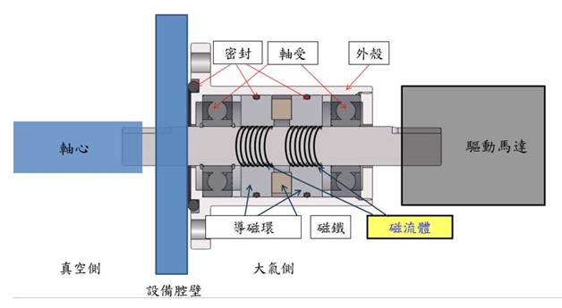
Discipline 4.定義及驗證真因 (Identify the Root Cause)
(Identify all potential causes which could explain why the problem occurred)
4.1 Non-conformance root cause (defect nature / technical root cause):
c) 真因驗證 (Root Cause Verification)
磁性流體轉子簡介： 磁流體軸封是利用磁流體之特性，搭配特殊的磁路設計，使其在軸心表面形成如「液體O-ring」之密封機構，藉此滿足軸心旋轉與腔體密封之需求。相較於其他類型之旋轉密封件，磁流體軸封具有低摩擦力、低粉塵、高密封性、高穩定性之特性，特別適合用於高科技產業之真空製程設備。透過磁流體軸封，使用者能夠將外部馬達的旋轉，傳遞至腔體內部，用以驅動各式機構動作或機械手臂。
磁性流體轉子剖面圖

Slide 25
Discipline 4.定義及驗證真因 (Identify the Root Cause)
(Identify all potential causes which could explain why the problem occurred)
4.1 Non-conformance root cause (defect nature / technical root cause):
c) 真因驗證 (Root Cause Verification)
磁性流體轉子分析：
Nitride 製程反應生成物 coating 較多，於 BPM 時皆會拆下磁性流體轉子清潔 & 確認是否有異音抖動 情形，如果異常即會更換之。
將磁性流體表面 coating 清除
異常下機之磁性流體內部 coating

Slide 26
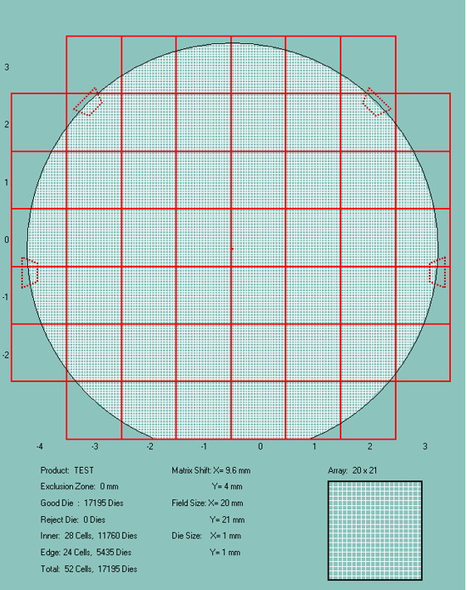
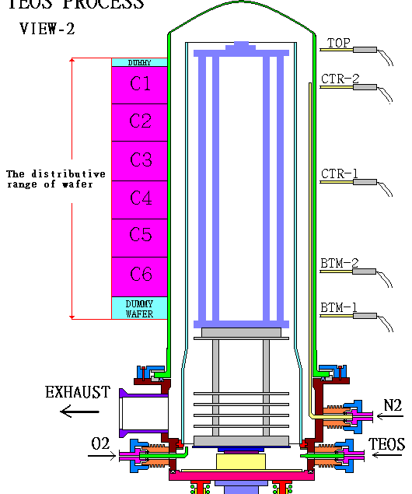
Discipline 4.定義及驗證真因 (Identify the Root Cause)
(Identify all potential causes which could explain why the problem occurred)
4.1 Non-conformance root cause (defect nature / technical root cause):
c) 真因驗證 (Root Cause Verification)
分析結論：
爐管使用磁性流體轉子承載 Pedestal & Boat & 170 pcs wafer。
若磁性流體轉子有卡頓抖動，會導致上方 wafer 與 boat pitch 摩擦，因而產生 particle defect。
Boat pitch 處
磁性流體轉子

Slide 27
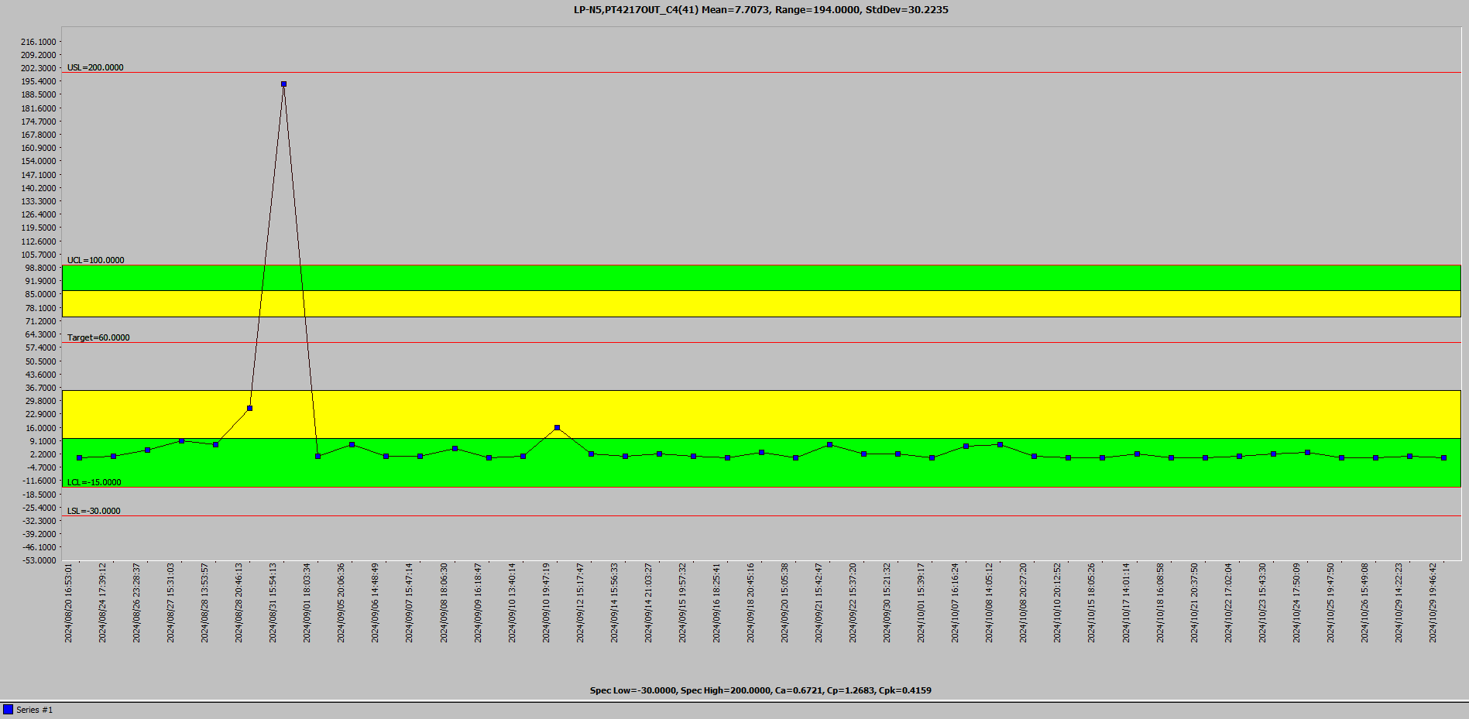
Discipline 4.定義及驗證真因 (Identify the Root Cause)
(Identify all potential causes which could explain why the problem occurred)
4.1 Non-conformance root cause (defect nature / technical root cause):
c) 真因驗證 (Root Cause Verification)
真因驗證：
更換磁性流體轉子，確認轉動時無異音及抖動。
Test run N01，C1/C4/C6 particle=0/0/0，release。
觀察更換磁性流體轉子後，2024/8/31~2024/10/31 particle 穩定。
真因為磁性流體轉子抖動產生 particle defect。
更換磁性流體轉子後

Slide 28
Discipline 4.定義及驗證真因 (Identify the Root Cause)
(Identify all potential causes which could explain why the problem occurred)
4.2 Non-detection / escape root cause (Provide reason to why the current system failed to detect)
a) 5-why:
Why LP-N5 會有產品報廢 ?
LP-N5 於 2024/8/25~2024/8/31 有多批 2 o’clock defect，其中一片 defect >5% 報廢。
Why 多批性 2 o’clock defect 僅發生至 2024/8/31 ?
因為 LP-N5 於 2024/8/31 C4 particle OOC 停機檢查機台。
Why LP-N5 2024/8/31 C4 particle 會 OOC ?
因為磁性流體異音抖動影響產品 particle。
Why 有發現磁性流體異音抖動影響產品仍造成產品報廢 ?
因為 particle all < 200ea in spec，產品洽 PE check 後 pass。
Why particle OOC，可以 pass ?
因為 OCAP<4217> Nitride particle 異常處理程序無定義 OOC 需進行處理。
b) Conclusion：
修改 OCAP<4217> Nitride particle 異常處理流程，particle OOC 需進行 rework 。

Slide 29
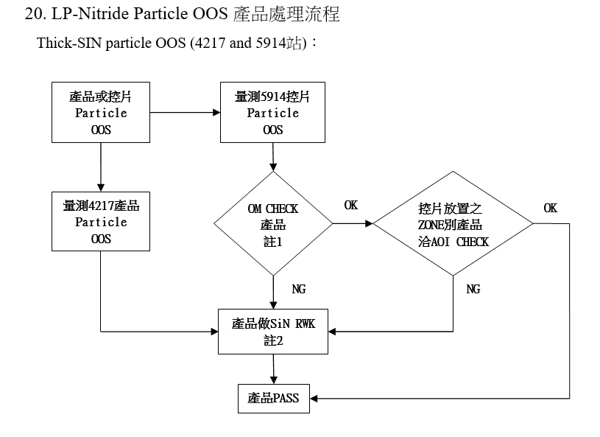
Discipline 5.擬定及驗證永久改善對策Choose and verify permanent corrective action (列出各項執行之對策並檢核其對策有效性)
5.1 What was the chosen corrective action to correct the root cause? (Add photo or diagram where applicable.)
修改 OCAP<4217> Nitride particle 異常處理流程，particle OOC 需進行 rework 。
修改前
無定義 OOC

Slide 30
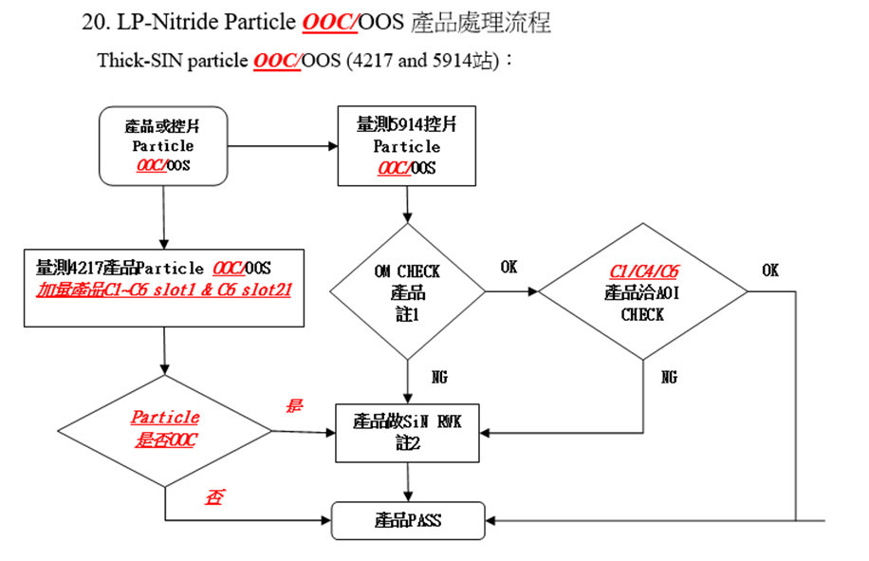
Discipline 5.擬定及驗證永久改善對策Choose and verify permanent corrective action (列出各項執行之對策並檢核其對策有效性)
5.2 Verification of actions effectiveness
修改 O.I number：G3212-3200 晶圓廠 擴散區異常處理規範內 OCAP<4217> Nitride particle OOC/OOS 異常處理流程，修改後處理流程如下。
修改後

Slide 31
Discipline 6.實施認永久改善對策Corrective Actions Implementation
6.1 For non-conformance root cause (defect nature / technical root cause):
Nbr. | Actions | Who | When | Remarks / Evidence (Document/Spec/Chart #)
1 | LP-N5 更換磁性流體轉子 | S220 | 2024/8/31 | Test run particle=0/0/0
6.2 For non-detection / escape root cause
Nbr. | Actions | Who | When | Remarks / Evidence (Document/Spec/Chart #)
1 | 修改 OCAP<4217> Nitride particle 異常處理流程，particle OOC 需進行 rework 。 | S210 | 2024/11/30 | G3212-3200 晶圓廠 擴散區異常處理規範

Slide 32
Discipline 6.實施認永久改善對策Corrective Actions Implementation
FMEA new item:
Item | Potential Failure Mode | Potential Effect(s) of Failure | S. E. V. | C L A S S. | Potential cause(s) / mechanism(s) of Failure | O. C. C. | Current Process Control Prevention | Current Process Controls Detection | D. E. T. | R. P. N. | Recommended Action | Responsibility & Target Completion Date | Action Results
Process, Function, Requirements |  |  |  |  |  |  |  |  |  |  |  |  | Actions Taken | S. E. V. | O. C. C. | D. E. T. | R. P. N.

Slide 33
Discipline 7.避免再發Prevent Recurrence (Modify System / Document)
7.1 Systemic Actions:
Factor | Actions | Who | When | Remarks / Evidence (Document/Spec/Chart #)
Practices/ Training | 更換磁性流體轉子 | S220 | 2024/8/31 | Test run particle=0/0/0
Work Instruction | 修改 OCAP<4217> Nitride particle 異常處理流程，particle OOC 需進行 rework 。 | S210 | 2024/11/30 | G3212-3200 晶圓廠 擴散區異常處理規範
Specification | NA | NA | NA | NA
Control Plan | NA | NA | NA | NA
* FMEA (must) | NA | NA | NA | NA
Error Proofing | NA | NA | NA | NA

Slide 34
Discipline 7.避免再發Prevent Recurrence (Modify System / Document)
7.2 Corrective Actions Fan-out: (水平展開):
Machine/ Process/ Product | Actions | Responsible | Due date
OCAP<4217> Nitride particle 異常處理流程 | 修改 OCAP<4217> Nitride particle 異常處理流程，particle OOC 需進行 rework 。 | S210 | 2024/11/30

Slide 35
Discipline 8. Congratulate the Team
Thanks for every member helped in this case.
Reviewed and Approved by:
Name | 2. Position | 3. Date
S200 李明驥 | DEPARTMENT MANAGER | 2024/11/11
S210 陳永昌 | SECTION MANAGER | 2024/11/11
S220 邱尊護 | SECTION MANAGER | 2024/11/11

